Slide 1


Structure dynamics
Paweł Dąbrowski-Tumański
MiNI Lecture, Fall 2025

Slide 2






Intro
Sześcian
🧬 Proteins move, fluctuate, and change shape
Sześcian
🤔 Static structures fail to explain function
Sześcian
❓ How does motion influence catalysis, binding, and regulation?
Sześcian
🎯 Molecular Dynamics lets us observe proteins *in action*

Slide 3

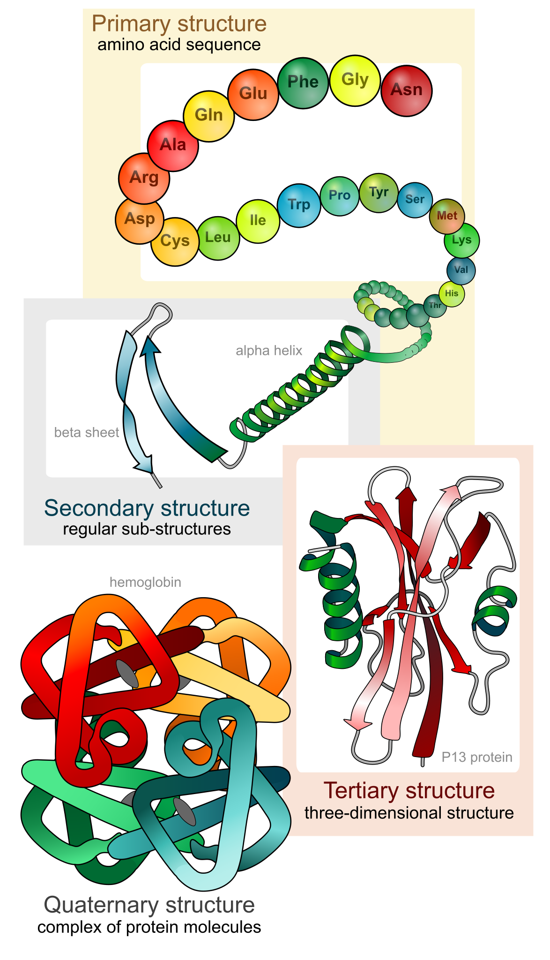



Four levels of protein structure
Sześcian
🔹 Primary → sequence
Sześcian
🔸 Secondary → α-helix, β-sheet
Sześcian
🔹 Tertiary → folded domain
Sześcian
🔸 Quaternary → multi-chain assembly

Slide 4
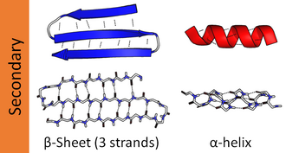
Structural motifs
Sześcian
🌀 α-helix
📐 β-hairpin / β-sheet
Sześcian
Sześcian
Sześcian

Slide 5
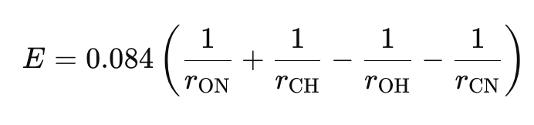
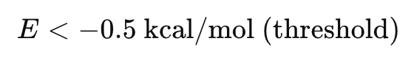
Dictionary of Protein Secondary Structure
Sześcian
Sześcian
Structure | Key Pattern | Example
α-Helix (H) | H-bond between residue i and i+4 | i → i+4
3₁₀-Helix (G) | i → i+3 | tighter helix
π-Helix (I) | i → i+5 | looser helix
β-Sheet (E) | Hydrogen bonds between strands | inter-strand
Turn (T) | Backbone reverses direction | sharp kink
Bend (S) | Local bend in backbone geometry | short deviation
Sześcian
Sześcian

Slide 6
Dictionary of Protein Secondary Structure
Sześcian
Code | Structure Type | Meaning
H | α-Helix | Standard right-handed alpha helix
G | 3₁₀-Helix | Tighter helix with 3 residues/turn
I | π-Helix | Wider, rare helix
E | β-Strand (in sheet) | Extended strand participating in β-sheet H-bonds
B | β-Bridge | Single-pair hydrogen-bonded beta interaction
T | Turn | Tight backbone turn (but not a helix)
S | Bend | Local curvature in backbone
— (or space) | Coil / Loop | No defined secondary structure
Sześcian
Sześcian
Sześcian

Slide 7
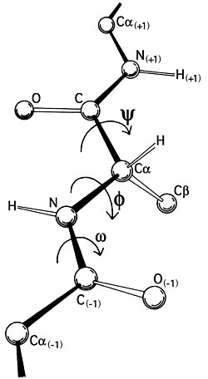
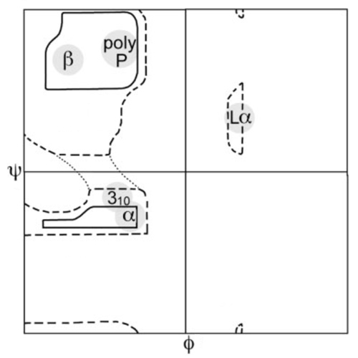
Ramachandran angles
Sześcian
📐 Each amino acid provides 3 bonds in backbone, but only two dihedral angles
Sześcian
Sześcian
Sześcian

Slide 8
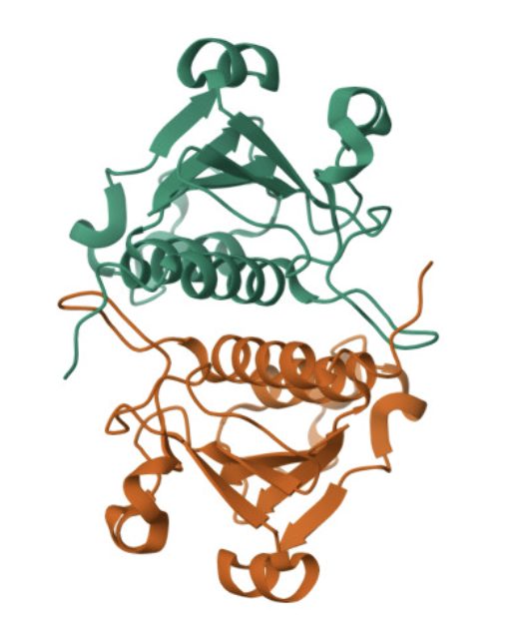
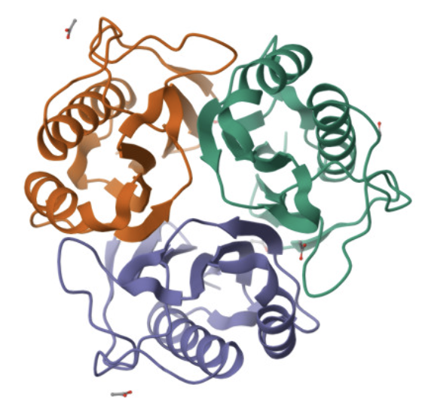
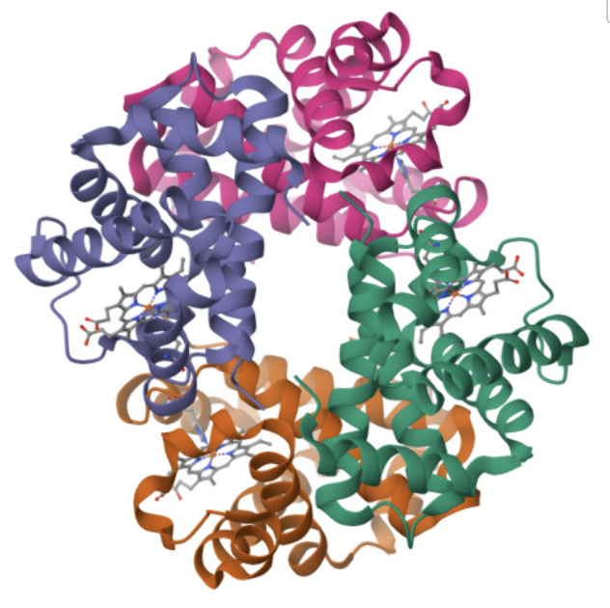
Homodimer, homotrimer, homotetramer…
Sześcian
Sześcian
Sześcian
Sześcian

Slide 9
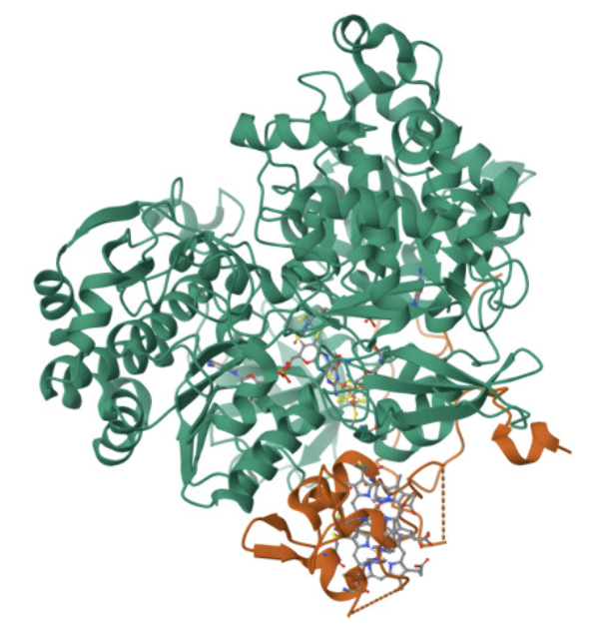
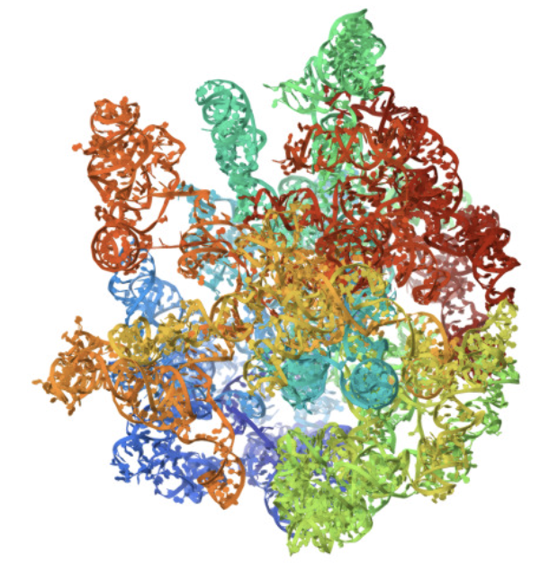
Heteropolymers
Sześcian
Sześcian
Sześcian
Sześcian

Slide 10
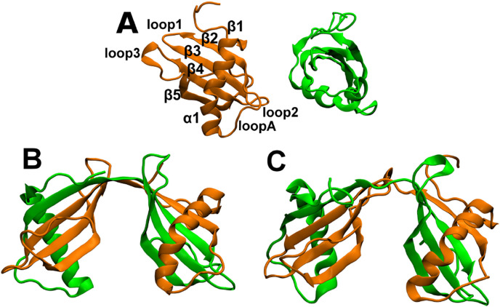
Domain Swapping
Sześcian
Sześcian
Sześcian
Sześcian

Slide 11
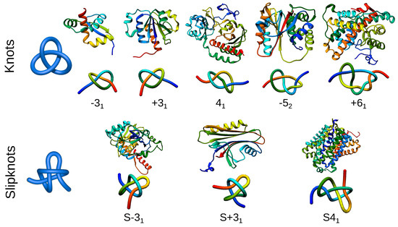
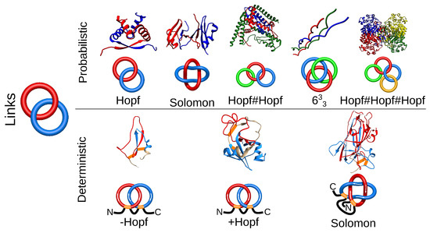
Protein knots and links
Sześcian
Sześcian
Sześcian
Sześcian

Slide 12
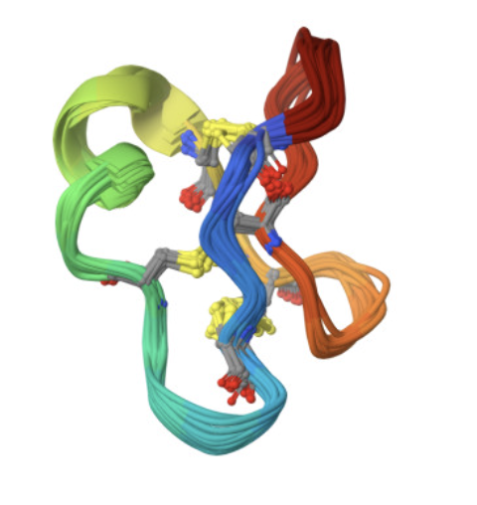
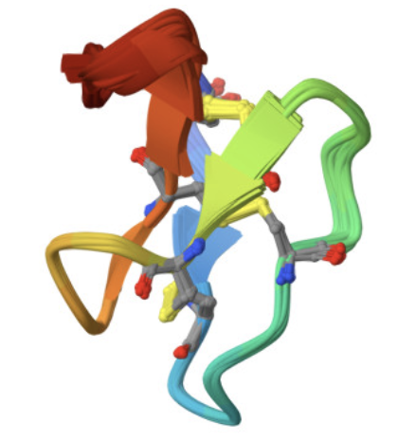
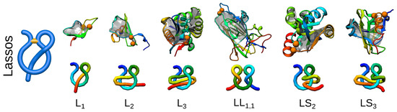
Cyclotides and Protein Lassos
Sześcian
Sześcian
Sześcian
Sześcian

Slide 13
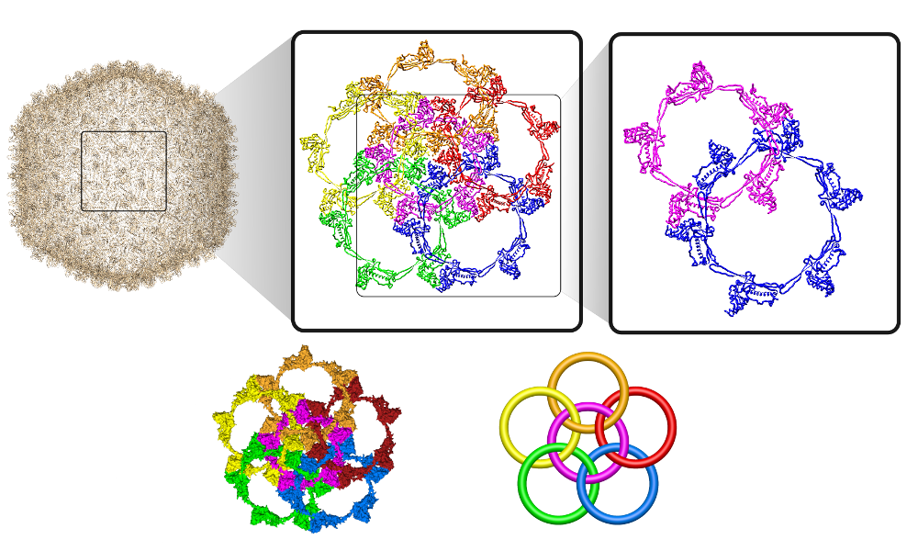
Large protein structures
Sześcian
Sześcian
Sześcian
Sześcian

Slide 14
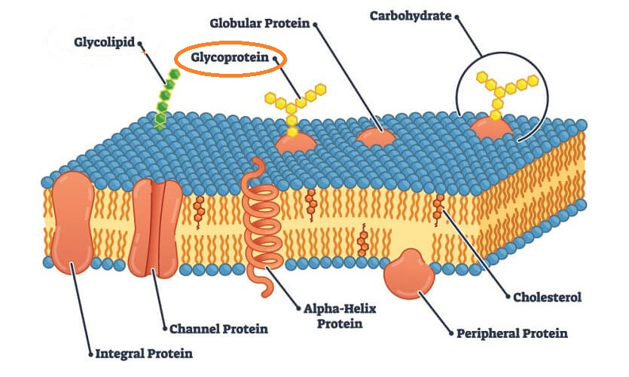
Post-translational modifications
Sześcian
🔗 Disulfide bridges → structural stabilization
Sześcian
🧷 Ubiquitination → degradation targeting
Sześcian
🧬 Glycosylation → stability & recognition
Sześcian
⚡ Phosphorylation → signaling switch

Slide 15
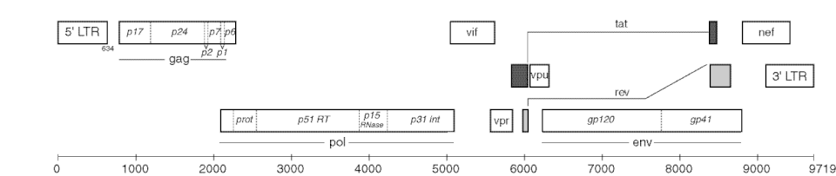
Protein domains
Sześcian
🧩 Domains = modular functional units
🏗️ Multi-domain proteins enable regulation
Sześcian
🔄 Swappable / evolvable units
Sześcian
Sześcian

Slide 16
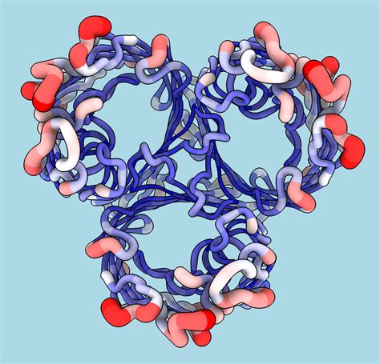
B-factor
Sześcian
🌡️ B-factor measures atomic displacement
Sześcian
📈 Higher B → more dynamic / uncertain region
Sześcian
🔢 B = (8π²/3) * <u²>
Sześcian
👀 Useful for identifying flexible loops

Slide 17
Structure measurement methods
Sześcian
Feature | X-ray Crystallography 💎 | NMR Spectroscopy 📻 | Cryo-EM ❄️🕵️
State of Sample | Protein must be crystallized 🧊 | Protein in solution 💧 | Protein frozen in vitrified ice ❄️
Works Best For | Medium proteins (10–200 kDa) ✅ | Small–medium proteins (< 40 kDa) 🎯 | Large complexes (> 150 kDa) 🏛️
Main Output | Electron density map 📡 | Distance restraints, chemical shifts 🔗 | Coulomb potential map 🌫️
Resolution | Usually high (1–3 Å) 🔍 | Moderate (depends on data) ⚖️ | Can be near-atomic (2–4 Å) ⭐
Key Limitation | Requires good crystals ❗ | Size limit + slow experiments 🐌 | Needs many particles + expensive equipment 💰
Sześcian
Sześcian
Sześcian

Slide 18
Structure measurement methods
Sześcian
Feature | X-ray Crystallography 💎 | NMR Spectroscopy 📻 | Cryo-EM ❄️🕵️
Strengths | Precise atomic detail 🔬 | Captures dynamics & flexibility 🌀 | Works for large complexes & membrane proteins 🧱
Typical Example | Enzymes, folded domains 🧩 | Flexible proteins, IDPs 🌊 | Ribosome, ion channels, viral capsids 🦠
Time Scale | Weeks-months depending on crystallization ⏳ | Days-weeks per structure 🧯 | Days-weeks once grid works 📆
Cost/Access | Moderately accessible 🏫 | Requires specialized expertise 🎓 | Very expensive microscopes 💎
Sześcian
Sześcian
Sześcian

Slide 19
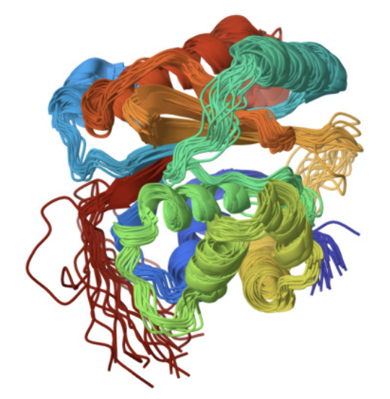
NMR structural ensamble
Sześcian
📚 NMR does *not* produce a single structure
Sześcian
🔁 Results = ensemble of conformers
Sześcian
Sześcian
⚖️ Reflects conformational flexibility

Slide 20
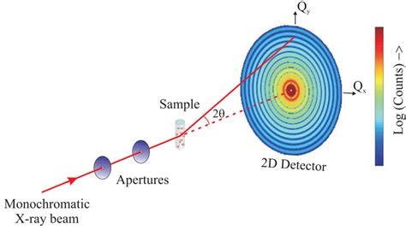
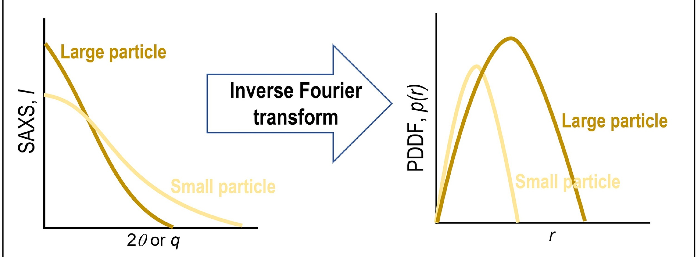
Small Angle X-ray Scattering
Sześcian
Sześcian
Sześcian
Sześcian

Slide 21
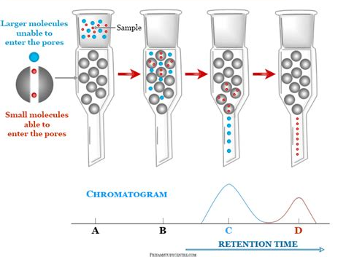
Size-exclusion chromatography
Sześcian
Sześcian
Sześcian
Sześcian

Slide 22
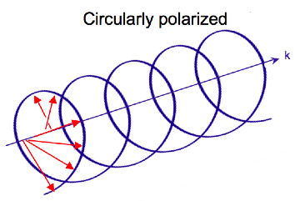
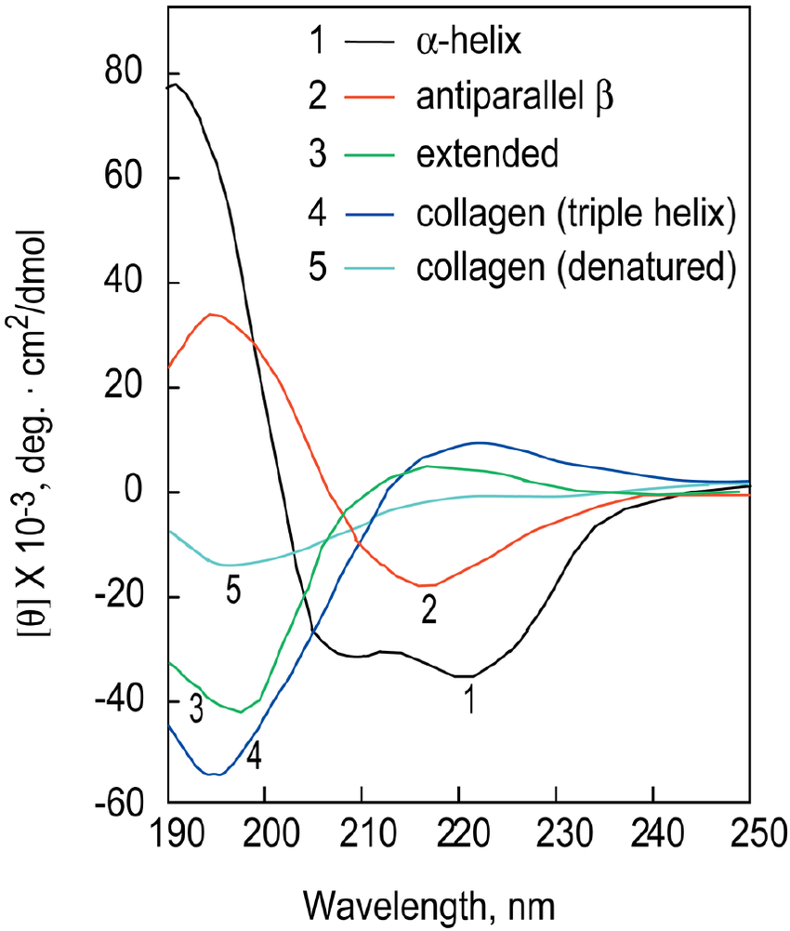
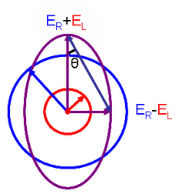
Circular dichroism in Far-UV
Sześcian
Sześcian
Sześcian
Sześcian

Slide 23

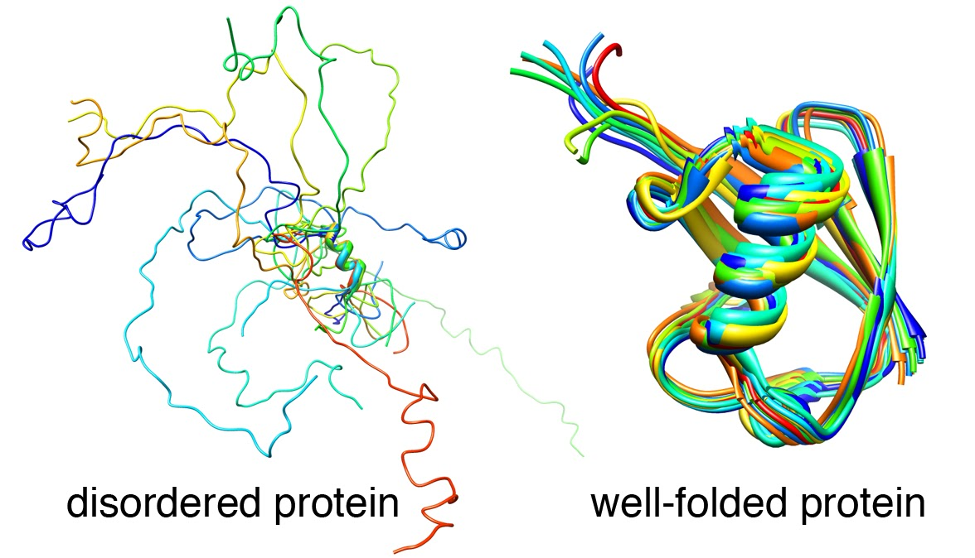

Intrinsically Disordered Protein
Sześcian
🧵 No single stable fold
Sześcian
🔗 Flexible & adaptive binding
Sześcian
Sześcian
🎛️ Common in signaling and regulation

Slide 24
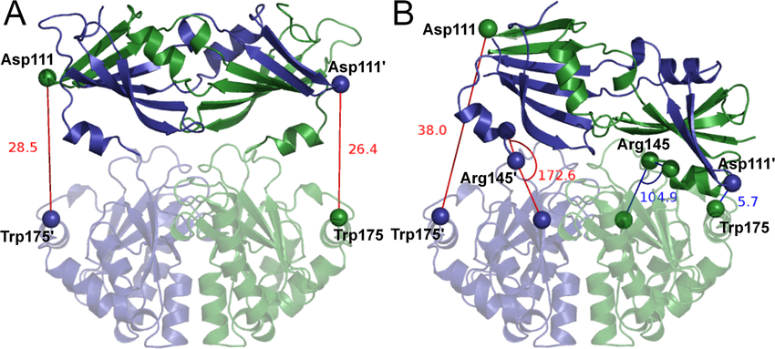
Binding-induced motion
Sześcian
🎭 Conformational selection vs induced fit
🎚️ Functional states exist in equilibrium
Sześcian
Sześcian
Sześcian

Slide 25
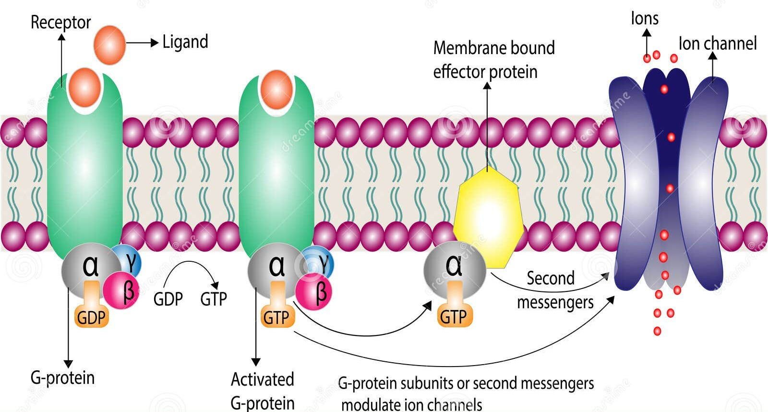
Receptor response
Sześcian
🎭 Agonist vs antagonist
🧲 Functional selectivity
Sześcian
Sześcian
Sześcian

Slide 26
Dynamic functional questions
Sześcian
🎛️ Allostery
Sześcian
⚙️ Enzyme catalysis
Sześcian
🚪 Ion channel gating
Sześcian
🧩 Aggregation and misfolding

Slide 27
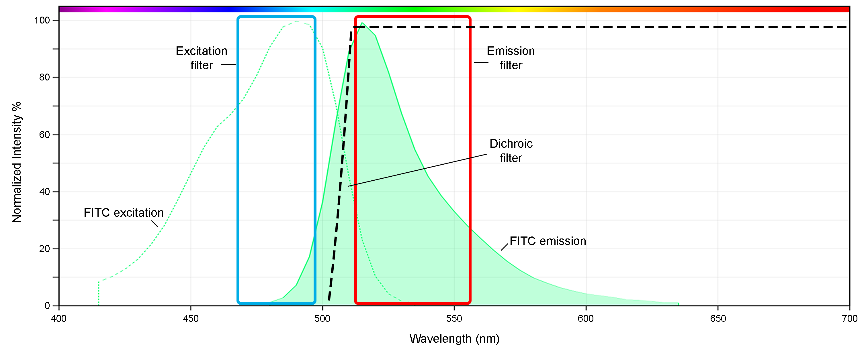
Fluorescence
Sześcian
🎛️ Aromatic residues react at UV light
⚙️ They emit own light
Sześcian
Sześcian
Sześcian
🚪 The light spectrum depends on the local environment

Slide 28
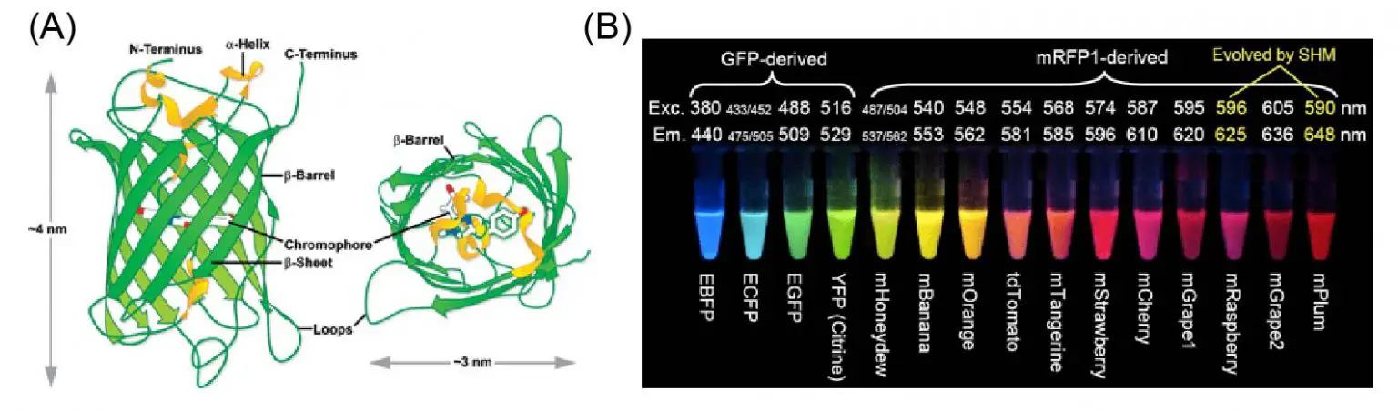
Fluorescence
Sześcian
Sześcian
Sześcian
Sześcian
🔷 Protein localization
🔷 Protein dynamics

Slide 29
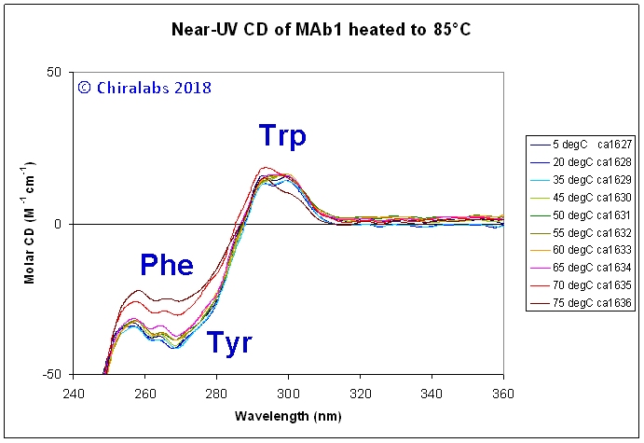
Circular dichroism – near UV
Sześcian
Sześcian
🔷 We can measure protein conformational changes also by CD
Sześcian
Sześcian

Slide 30
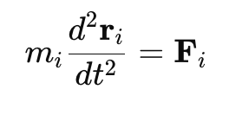
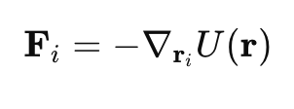

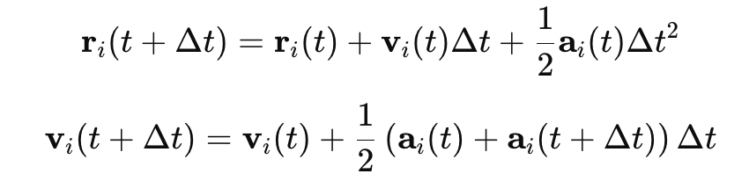
What is Molecular Dynamics?
Sześcian
Sześcian
🧮 Solve Newton’s equations iteratively
Sześcian
⚛️ Atoms move under interatomic forces
Sześcian
🔁 Produces time-dependent structural trajectory
Sześcian

Slide 31
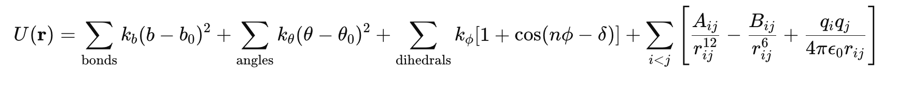
Force Fields
Sześcian
Sześcian
Sześcian
📦 AMBER, CHARMM, OPLS, GROMOS, …
Sześcian
🎚️ Balance between accuracy & speed
🔬 Derived from QM & experimental energies
Sześcian

Slide 32
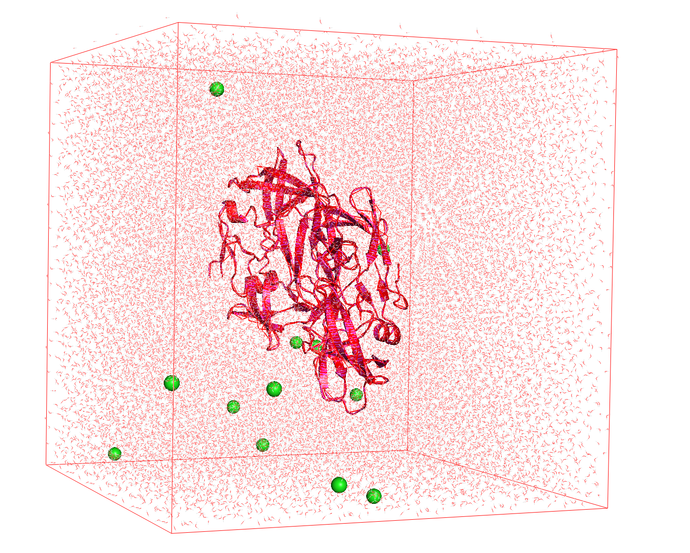
MD workflow
Sześcian
Sześcian
🧪 Assign protonation states (pH)
Sześcian
💧 Solvate & add ions
Sześcian
⬇️ Minimize → 🔄 Equilibrate → ▶️ Production run
Sześcian

Slide 33
Why it is hard
Sześcian
Sześcian
⚛️ 10⁵–10⁶ atoms typical
Sześcian
⏱️ 1–2 fs timestep
Sześcian
📏 ns–ms trajectories require 10⁸–10⁹ steps
Sześcian
💻 Computationally expensive

Slide 34
Speeding up
Sześcian
Sześcian
💧 Implicit solvent (remove explicit water)
Sześcian
✂️ Cutoffs & constraints
Sześcian
⚙️ Hardware acceleration (GPUs)
Sześcian
🔲 On-latice calculation

Slide 35
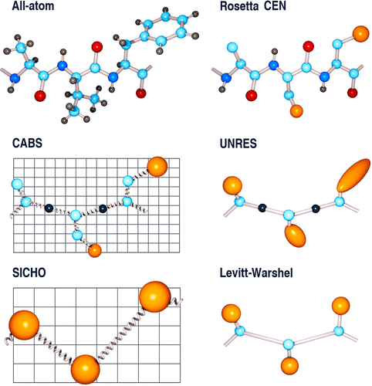
Coarse graining
Sześcian
Sześcian
⚫ Groups atoms → beads
Sześcian
⏩ Longer timescales, less detail
Sześcian
Sześcian
🧰 E.g., CABS, UNRES, MARTINI model

Slide 36
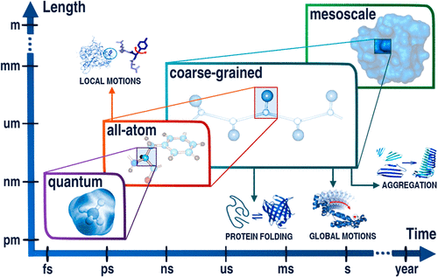
Timescales again
Sześcian
Sześcian
⚡ QM: fs–ps
Sześcian
🔬 Atomistic MD: ns–µs
Sześcian
⏩ Coarse-grained: µs–ms
Sześcian
🐢 Elastic networks: ms–s

Slide 37
Anfinsen’s principle & Levintahal’s paradox
Sześcian
Sześcian
♻️ Sequence determines native structure
Sześcian
Sześcian
🧩 Exploring conformations „on random” would take longer than the age of the Univerese
Sześcian

Slide 38
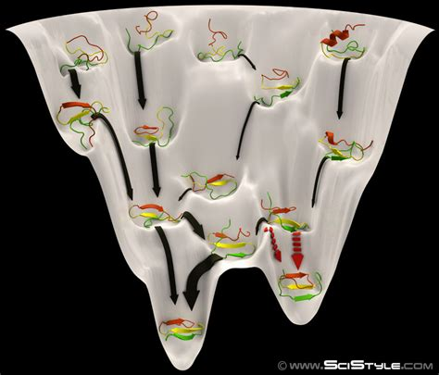
Energy landscape & Folding funnel
Sześcian
Sześcian
🕳️ Proteins fold by minimizing free energy
Sześcian
Sześcian
🔽 Funnel landscape model
Sześcian
🔄 Multiple metastable states

Slide 39
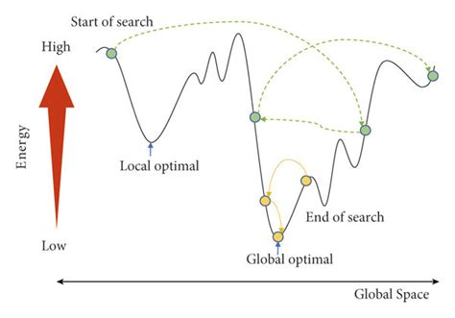
Simulated annealing
Sześcian
Sześcian
Sześcian
Sześcian
Sześcian

Slide 40
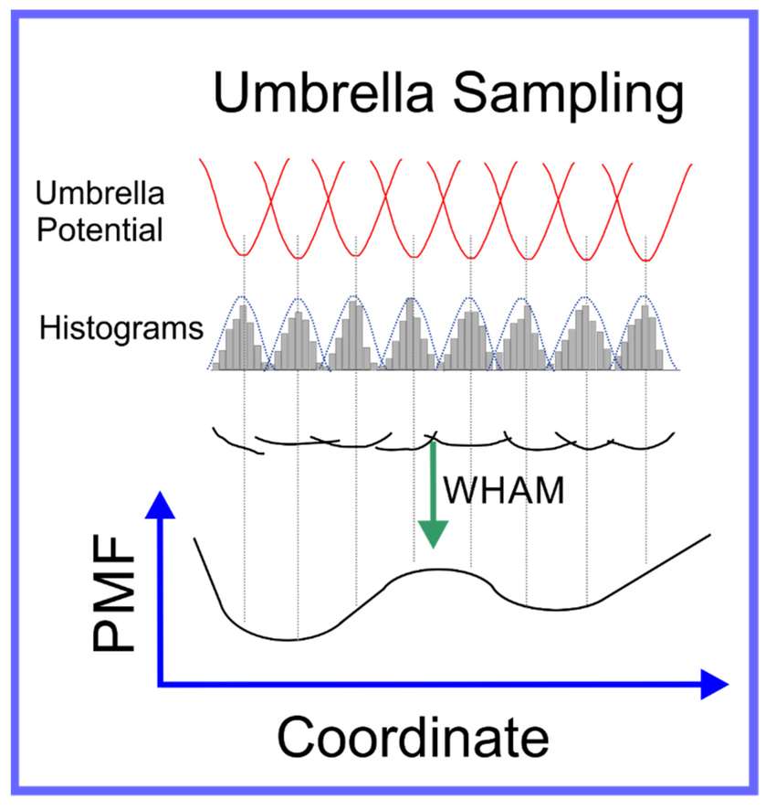
Umbrella Sampling
Sześcian
Sześcian
Sześcian
Sześcian
Sześcian

Slide 41
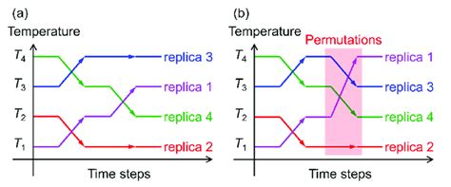
Replica Exchange MD
Sześcian
Sześcian
Sześcian
Sześcian
Sześcian

Slide 42
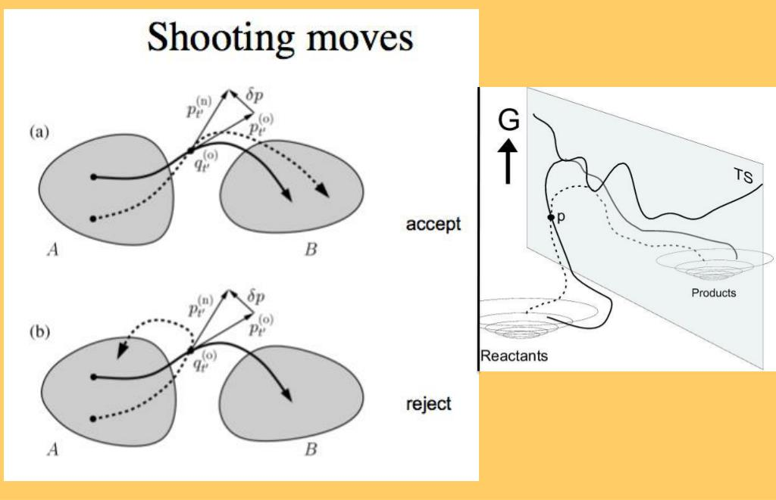
Transition path sampling
Sześcian
Sześcian
Sześcian
Sześcian
Sześcian

Slide 43
Speeding up by Deep Learning?
Sześcian
Sześcian
🧠 Neural force fields (MACE, ANI, NequIP)
Sześcian
🔮 Generative trajectory prediction
Sześcian
🌉 Learned coarse-graining
Sześcian

Slide 44
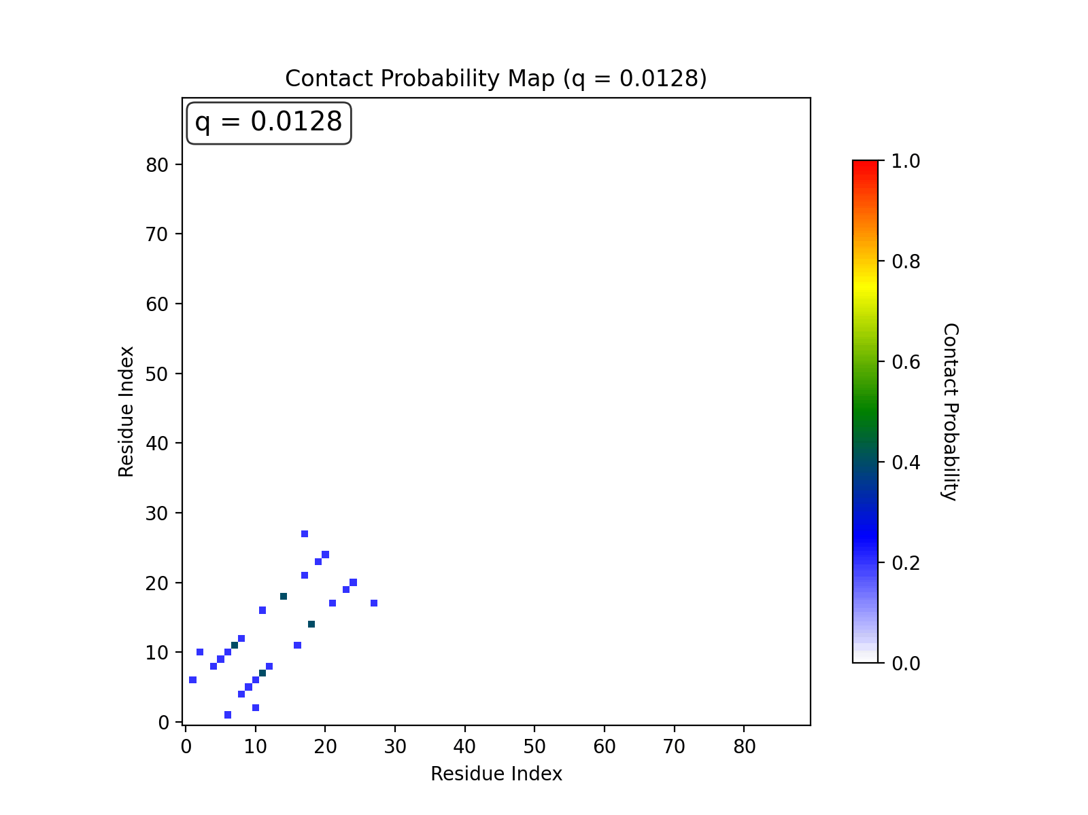
Trajectory analysis
Sześcian
Sześcian
📊 RMSD & RMSF
Sześcian
🔗 Contact maps
Sześcian
💦 Hydrogen bond networks
Sześcian

Slide 45


Gromacs
Sześcian
🚀 Optimized for speed
Sześcian
🧱 Focus on biomolecules
🔧 User-friendly workflows
Sześcian
🖥️ Highly parallelized
Sześcian
🧪 Rich set of force fields
🌍 Active community
💧 Excellent water and membrane simulation performance

Slide 46
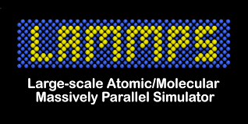
LAMMPS
Sześcian
🧠 Designed for materials science
Sześcian
🔌 Highly modular and extensible
⚙️ Supports many interactions
Sześcian
📏 Efficient for very large systems
Sześcian
🧲 Can model mechanical stress, thermal behavior, deformation
🌐 Scales extremely well on HPC systems

Slide 47

NAMD
Sześcian
💎 Designed for biomolecular systems at large scale
Sześcian
🧬 Uses the CHARMM force field natively
Sześcian
💻 Optimized for parallel supercomputing
Sześcian
🤝 Supports hybrid CPU/GPU acceleration
📈 Very efficient for long timescale simulations of big complexes

Slide 48
Traditional tools comparison
Sześcian
Feature / Strength | GROMACS | LAMMPS | NAMD
Focus | Biomolecules | Materials Science + Custom Models | Large Biomolecular Complexes
Speed (biomolecules) | ⭐⭐⭐⭐⭐ | ⭐⭐ | ⭐⭐⭐⭐
Flexibility / Custom Potentials | ⭐⭐ | ⭐⭐⭐⭐⭐ | ⭐⭐⭐
Best Hardware Use | GPU + Multi-core | Massive HPC Clusters | HPC Clusters + GPU
Workflow Friendly | Yes | Moderate (script-heavy) | Yes (via VMD)
Sześcian
Sześcian
Sześcian

Slide 49

OpenMM
Sześcian
🧱 Flexible, modular molecular dynamics engine
Sześcian
🐍 Native Python API
⚡ GPU-first architecture
Sześcian
🧬 Supports standard biomolecular force fields
Sześcian
🧪 Ideal for custom simulation protocols
✅ Best choice for: MD + Python + customization

Slide 50
Deep learning force fields
Sześcian
Model | Notes | What it predicts
ANI / ANI-2x / AIMNet | Neural approximations of QM energies | Forces & energies for small molecules
SchNet | Continuous-filter GNN | Forces & energies
PhysNet | Energy + dipole learning | Forces & energies
NequIP (Neural E(3)-Equivariant) | Extremely accurate for small protein fragments | Forces & energies
MACE / MACE-MD ⭐ | One of the current state-of-the-art | High-accuracy scalable force fields
Allegro (equivariant TensorNet) | Designed for large-scale trajectories | Forces & energies
TorchMD-Net | Biopolymer-specific force learning | Forces + inference inside OpenMM
Sześcian
Sześcian
Sześcian

Slide 51
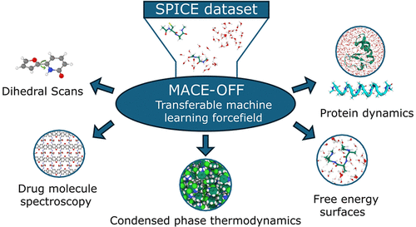
MACE force field
Sześcian
Sześcian
Sześcian
Sześcian

Slide 52
Generating distribution of structures
Sześcian
Model | Approach | Output
Boltzmann Generators (Noé Lab) | Normalizing flows | Samples equilibrium conformations directly
Diffusion-based Protein Ensemble Models | Score matching | Generates alternative conformations
EquiBind / DiffDock | Geometric diffusion | Binding pose ensemble predictions
AlphaFold Multimer Relaxation Ensemble | MM-like relaxation | Local structural dynamics (limited)
Sześcian
Sześcian
Sześcian

Slide 53
Generating transitions between states
Sześcian
Sześcian
Model | Idea | Notes
Variational Dynamics Encoder (VDE) | Learn slow collective modes | Captures long-timescale dynamics
Markov State Models + VAMPNet (Noé Lab) | Learn kinetic landscapes | Produces transition probabilities
TICA / Koopman operator neural models | Learn slow degrees of freedom | Used with MD / cryo-EM / NMR ensembles
Sześcian
Sześcian

Slide 54
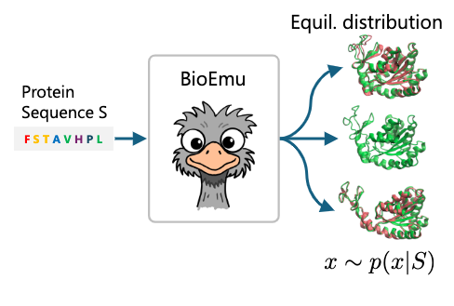
BioEmu
Sześcian
Sześcian
Sześcian
Sześcian

Slide 55

AlphaFlow
Sześcian
Sześcian
Sześcian
Sześcian

Slide 56
Generating Trajectories
Sześcian
Model / Research Direction | Status
Diffusion models for molecular motion (DM4MD, 2024 preprints) | Can generate short protein motions
Video-Diffusion models for biomolecular dynamics | Experimental / not stable
RNA / Protein coarse-grained diffusion dynamics (CGDiff) | Works only for coarse-grained beads
“Molecular Dance Diffusion” (2025 bioRxiv) | promising, still unstable for long trajectories
Sześcian
Sześcian
Sześcian

Slide 57





Wrap-Up
Sześcian
🔷 A protein’s function depends also on its intrinsic motions, flexibility, shifts between conformational states.
🔷 Proteins are 3D structures whose shape and function arises from amino acid sequence
Sześcian
Sześcian
🔷 MD simulates motion over time by iteratively integrating Newton’s equations from a force field
🔷 Practical MD uses specialized software and analysis libraries built for efficient analysis

